Slide 1
THESIS
Implementation and Design of a Magnetic Application Demonstrator
from Julia Kabalar
& Thomas Wurzer

Slide 2
CONTENT
THESIS TEAM
PROJECT ADVISER & INVOLVED COMPANIES
SYSTEM STRUCTURE
ORGANISATION STRUCTURE
COST CALCULATION

Slide 3
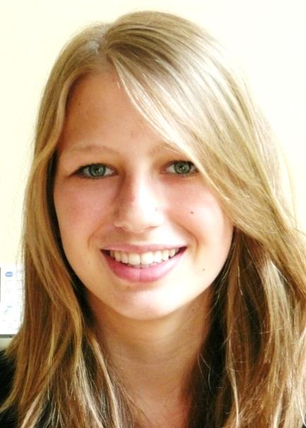
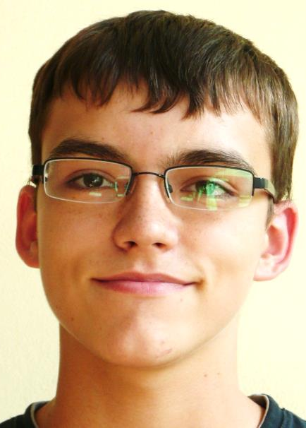
THESIS - TEAM
Julia Kabalar Thomas Wurzer

Slide 4
PROJECT ADVISER & INVOLVED COMPANIES
Dr. Fritz Rasbornig – project supervisor
Infineon Technologies Austria AG
Dr. Michael Seger – leading engineer
Carinthian Tech Research AG
OStR. Prof. Dipl.-Ing. Karl Lechner
HTL Mössingerstraße

Slide 5
SYSTEM STRUCTURE
Demonstrator
µC
stepper motors
sensor
measures magnetic field
sends information to µC
controls the display
processes measured data from sensor
display
Stepper motor drivers
controls the distance of the magnet
shows information from sensor
controls the motors

Slide 6
ORGANISATION STRUCTURE
costumer: Infineon Technologies Austria AG
developing companies:
Infineon & CTR
team leader: Thomas Wurzer
Julia Kabalar
part leader of:
Thomas Wurzer
part leader of
information collection
display
controlling the stepper motors
sending/receiving information from µC
µC
stepper motors
connection to stepper motor drivers
sensor
program implementation of the code
programming

Slide 7
COST CALCULATION
COST CALCULATION - material
display | 700 €
stepper motors | 100 €
battery | 150 €
stepper motor driver | 50 €
µC | 150 €
other mechanical components | 500 €
 | 1.650 €
10% reserves | 165 €
total material costs | 1.815 €

