Slide 1
THESIS
Implementation and Design of a Magnetic Application Demonstrator
Julia Kabalar
& Thomas Wurzer

Slide 2
Content
1.
Short Overview
Boundaries
2.
Cost Calculation
3.
Software & Interfaces
Programming & Visualisation
Construction

Slide 3
Project Facts
5 cm linear movement of a magnet
→ Stepper motor
Sensor measures magnetic field
→ Distance
Measurement and position of the magnet shown on the display

Slide 4
Short Overview
Demonstrator
Targets
Non-Targets
Circuit board planning & production
Construction of the demonstrator
Designing a display user interface
µC programming: interfaces, protocolls
Algorithm development for imbedding sensor

Slide 5
Social Boundaries
HTL Team
Co-operation
Customer
Dr. Fritz Rasbornig
Michael Huber
Dr. Michael Seger
Prof. Dipl.-Ing.
Karl Lechner

Slide 6
Project Progress
Board manufacturing
Display visualisation
Initialisation of the µC
Communication to stepper motor
Communication to the sensor

Slide 7
COST CALCULATION
Material
display | 700 €
stepper motor + driver | 200 €
batteries | 150 €
µC | 150 €
other mechanical components | 500 €
software licences | 300 €
 | 2.000 €
10% reserves | 200 €
total material costs | 2.200 €
Personal costs
Student | 6.000 €
HTL-Team | 3.000 €
other personal costs | 4.000 €
total personal costs | 13.000 €

Slide 8
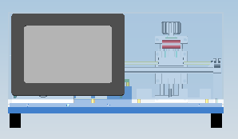
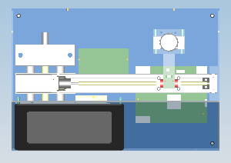
Construction

Slide 9
Software
DAvE
KEIL (earlier Tasking VX-Toolset)
Solid Works
EA LCD-Tools Portable

Slide 10
Interfaces / Communication
Microcontroller
Display
Sensor
Stepper motor
Power supply
RS232
ASC Protocol
SPI

Slide 11
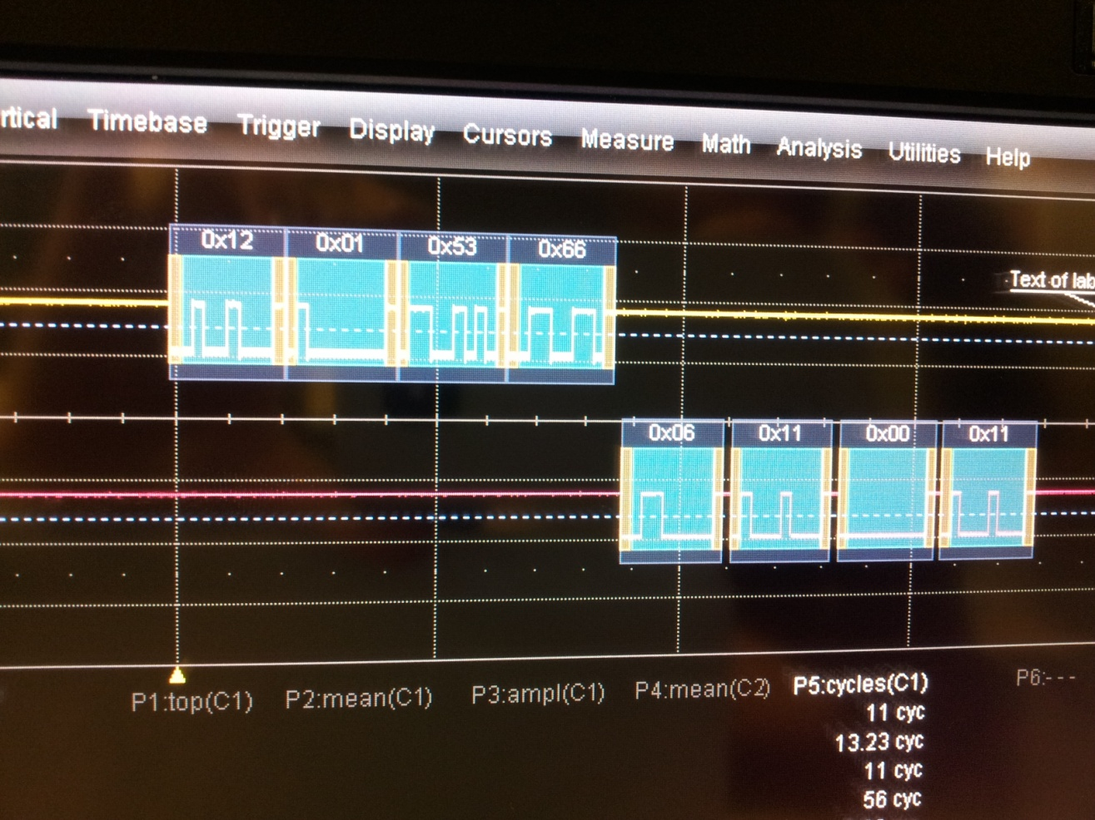
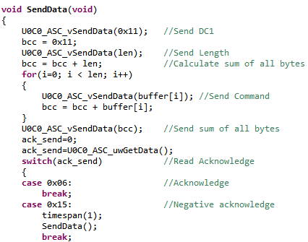
Programming
Display
µC

Slide 12
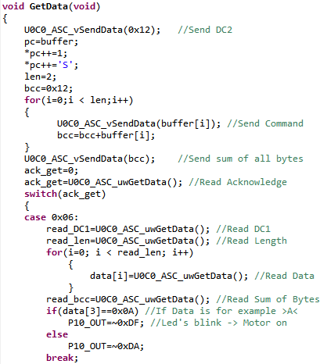
Programming
Display
µC

Slide 13
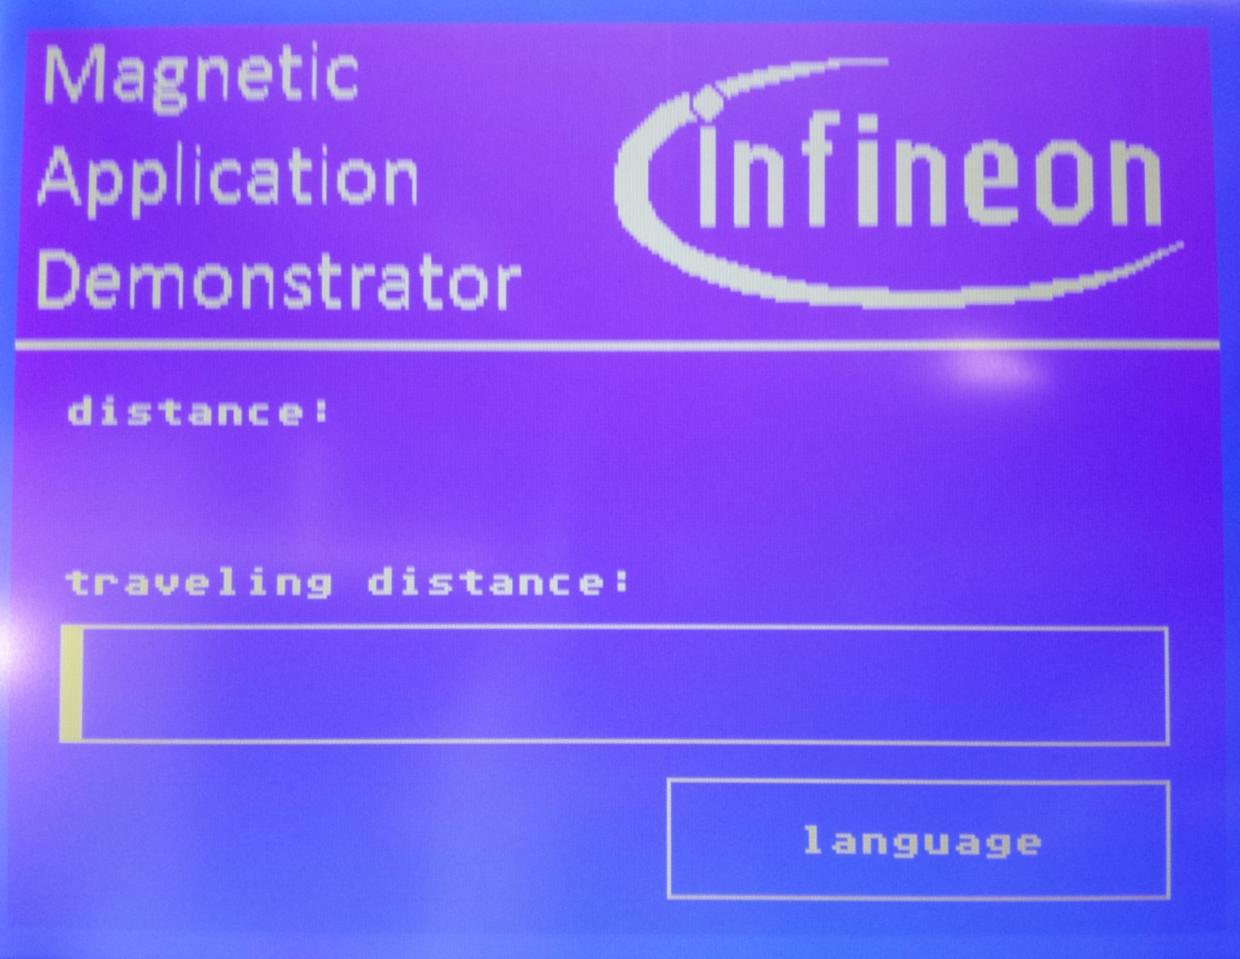
Visualisation

Slide 14
Sources
http://de.123rf.com/photo_7296574_3d-tick-zeichen.html
(accessed on 30th November)
http://de.123rf.com/photo_7248091_3d-abgelehnten-zeichen.html
(accessed on 30th November)
http://www.lcd-module.de/
(accessed on 30th November)

Slide 15
The 3 most important things in programming are: Timing, Timing & Timing !!! Prof. Dipl.-Ing. Karl Lechner
The End

