Slide 1
THESIS
Implementation and Design of a Magnetic Application Demonstrator
Julia Kabalar
& Thomas Wurzer
Notes:
Thomas

Slide 2
Content
1.
Short Overview
2.
Plan of Results
3.
Next Steps
Construction
Magnetic Field Sensors
Display Visualisation
Notes:
Thomas

Slide 3
Social Boundaries
HTL Team
Co-operation
Customer
Dr. Fritz Rasbornig
Michael Huber
Dr. Michael Seger
Prof. Dipl.-Ing.
Karl Lechner
Notes:
Thomas

Slide 4
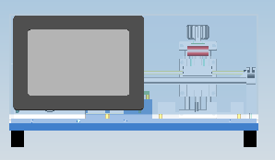
Project Facts
5 cm linear movement of a magnet
→ stepper motor
Sensor measures magnetic field
→ distance
Measurement and position
of the magnet shown on the display
Notes:
Thomas

Slide 5
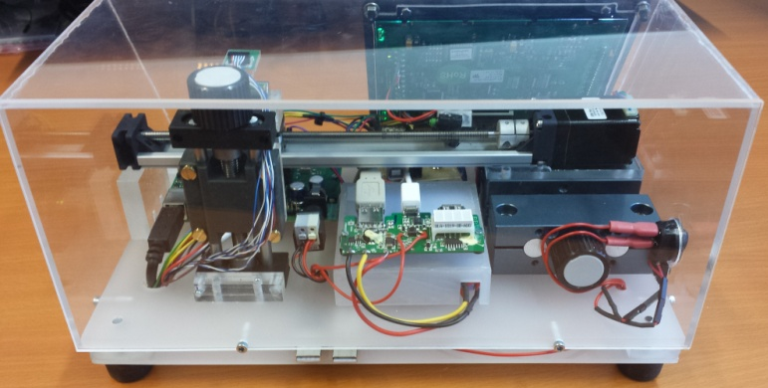
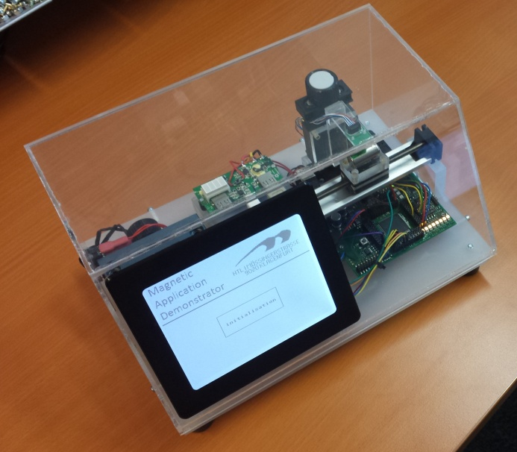
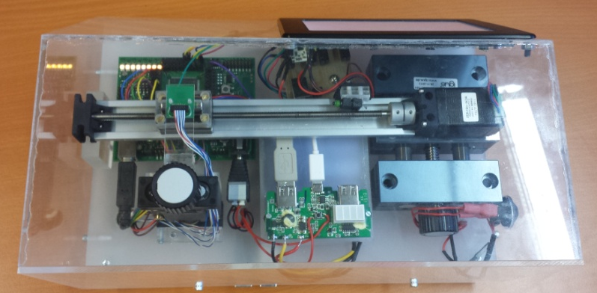
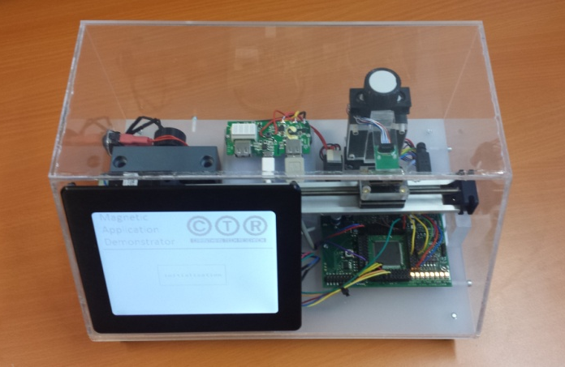
Construction

Slide 6
Plan of Results
09.09.2013
Set and ordering of the components
Gathering information for the project
31.11.2013
Communication to display
17.02.2014
Interacting with stepper motor
Define interfaces
24.03.2014
Details for visualisation
Communication to the sensor
30.04.2014
Finalization
Project documentation
Participation in competitions
07.01.2014
Basic visualisation for display
Circuit board construction
Get distance through display
Notes:
Thomas

Slide 7
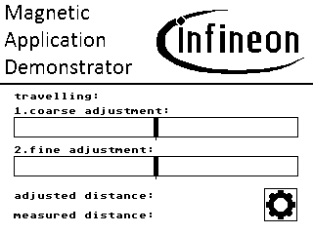
Display Visualisation

Slide 8
Magnetic Field Sensors
Magnetic Field Measurement
Radar equipment
Automotive industry
Current measurement
Smart grid
Seldom ores in the ground

Slide 9
Next Steps
Control stepper motor via display
Details for visualisation (graph,..)
Sensor communication
Participation in competitions
innovation@school
27.02.2014

Slide 10
Thanks for your attention !

Slide 11
Sources
http://de.123rf.com/photo_7296574_3d-tick-zeichen.html
(accessed on 30th November)
http://de.123rf.com/photo_7248091_3d-abgelehnten-zeichen.html
(accessed on 30th November)
http://www.lcd-module.de/
(accessed on 30th November)

